Slide 1


NLP Analysis of Continuous Glucose Monitoring (CGM) for Diabetes
~ Akshita, Aditi, Mia, Kaushal

Slide 2

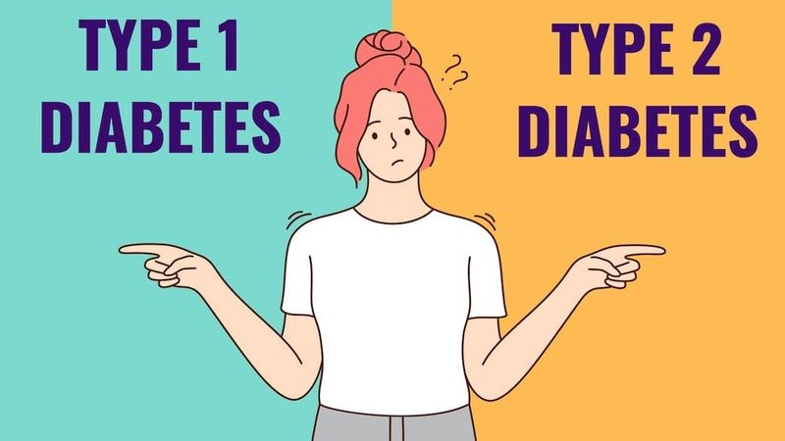
Background
Diabetes - metabolic disease, causes high blood sugar
Diabetes direct cause of 1.5 million deaths in U.S.
10% (body can’t produce enough insulin)
90% (can’t use the insulin it makes)

Slide 3
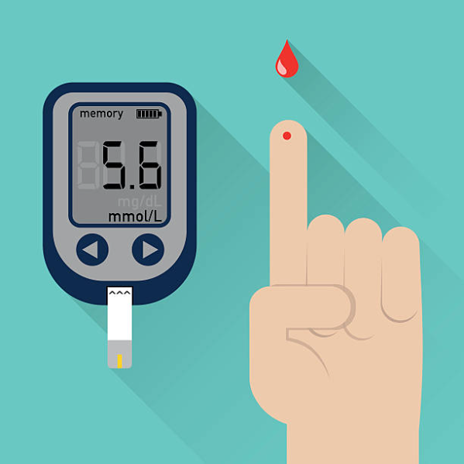
Finger-stick method for Glucose Measurement
Drawbacks
Pain and Discomfort: Repeated pricking can cause soreness.
Inaccuracy: Dirt or improper procedure lead to inaccurate results.
Cost: Strips and lancets are consumable; costs add up over time.
Inconvenience: Inconvenient for folks with frequent monitoring (Type 1 diabetes)

Slide 4
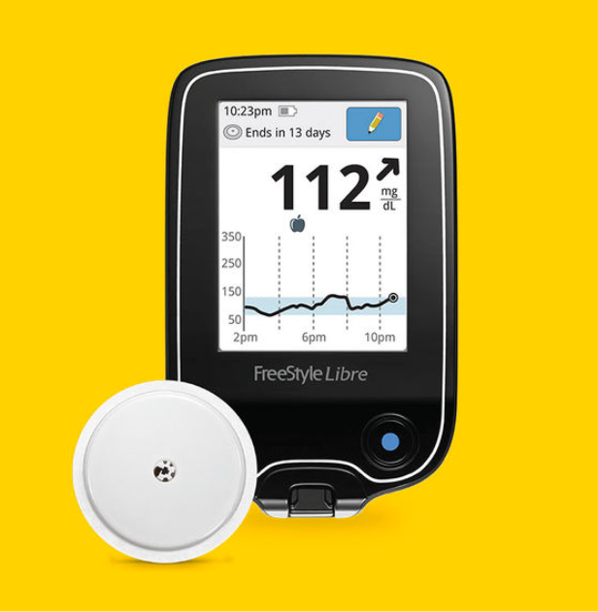
Continuous Glucose Monitoring
Why CGM?
Continuous Data: Offers round-the-clock glucose monitoring.
Convenience: Reduces need for frequent finger pricks.
Real-time Alerts: Gives instant high/low glucose warnings.
Cost-Effective: Long-term savings by reducing test strip usage.

Slide 5



Problem Statement
Analyze social media data on Continuous Glucose Monitoring (CGM)
37K social media posts
Understand the general trend
Emotions of users around CGM and CGM products
Discover insights to help companies and customers improve decision

Slide 6


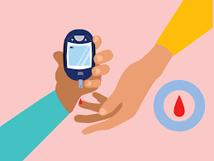
Target Customers
Industry Stakeholders
End Users and Potential Consumers
Health Insurers

Slide 7
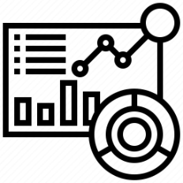

Exploratory Data Analysis
Raw Data Overview
Data Cleaning

Slide 8

Raw Data Overview
26%
7%
Positive Sentiment about CGM Negative Sentiment about CGM
64%
3%
Neutral Sentiment about CGM Mixed Sentiment about CGM

Slide 9
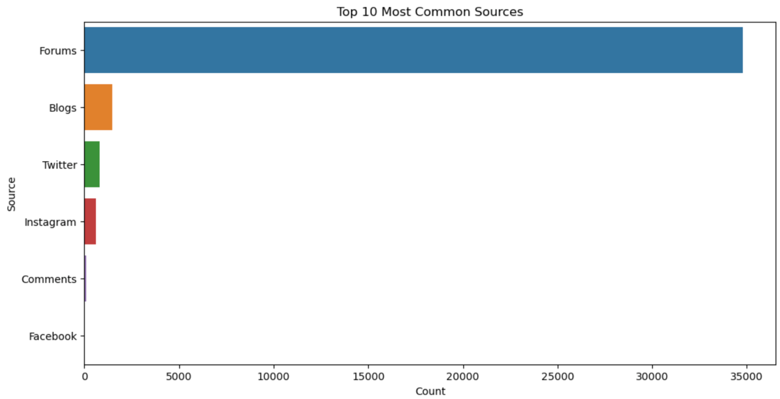
Top 10 common sources of the data

Slide 10
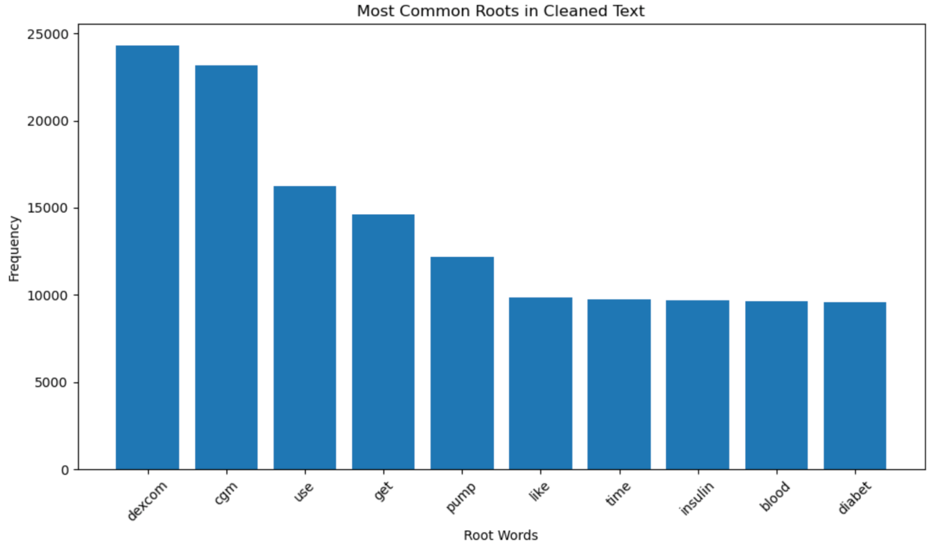
Data Cleaning

Slide 11
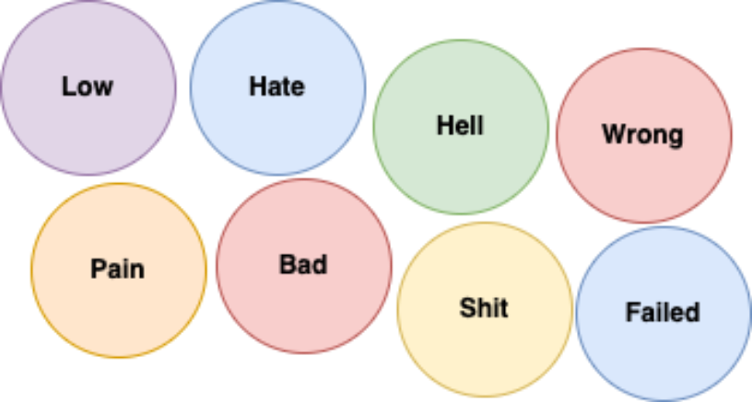
Sentiment Analysis using Vader
Sentiment Score 1 & 2 - Negative

Slide 12
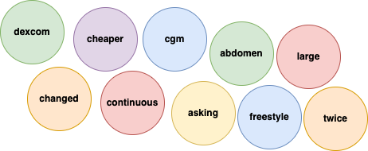
Sentiment Score 3 - Neutral

Slide 13
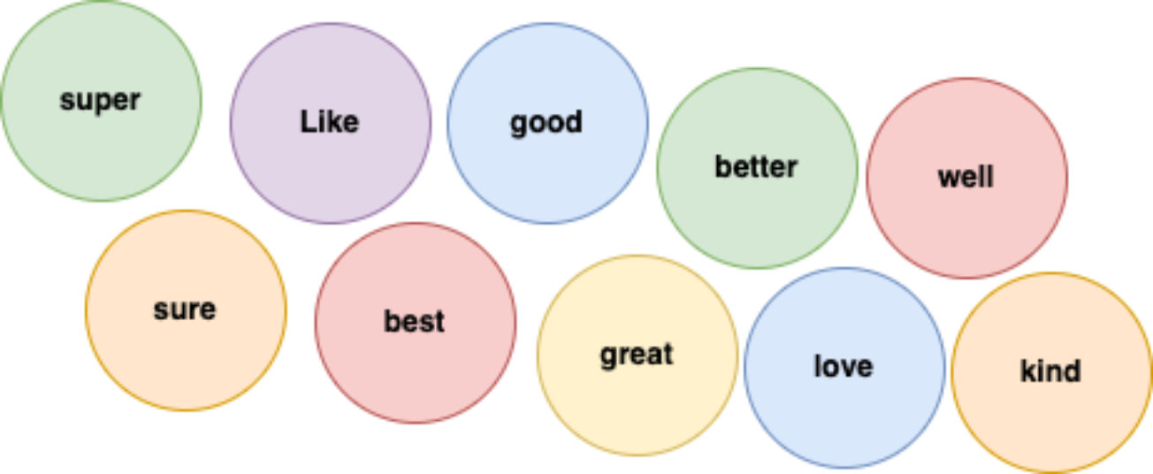
Sentiment Score 4 and 5 - positive

Slide 14
Topic Modelling using LDA
Topic 0: General discussion about selecting a CGM. Mentions popular brands like Dexcom and Freestyle Libre. It focuses on the selection, costs, and insurance implications.
Topic 1: Importance and utility of CGMs for managing diabetes, especially in differentiating between Type 1 and Type 2 diabetes.
Topic 2: Personal experiences with using CGMs, their impact on understanding blood sugar trends, and the comparison between finger pricking vs. CGMs.
Topic 3: Experiences related to wearing the device. Examples include adhesive issues, site selection, and physical interactions with the device.

Slide 15
Topic Modelling using LDA
Topic 4: Technology-related issues with the devices. This involves signal issues, technical glitches, and experiences with different brands.
Topic 5: Feedback and recommendations regarding specific brands and device models.
Topic 6: Specific readings, accuracy, and personal experiences with CGMs
Topic 7: Discussions on specific brands, models, and their features. This includes mentions of transitioning between different models or brands.

Slide 16
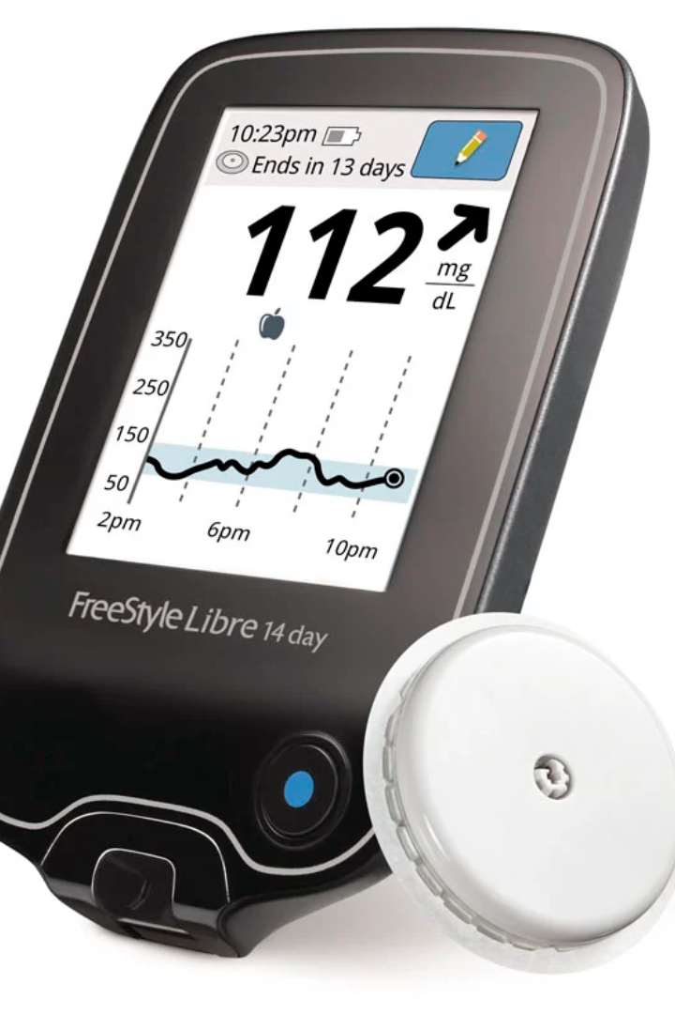
General CGM Analysis
Patient expectations of CGMs
Accurate, reliable, and affordable.
Real-time Alert
Continuous Glucose Monitoring
Patient knowledge gaps with CGMs :
How to use them effectively
How to interpret the data
Technical and Software Challenges
Understanding Sensor Limitations and Duration
Feature Awareness

Slide 17
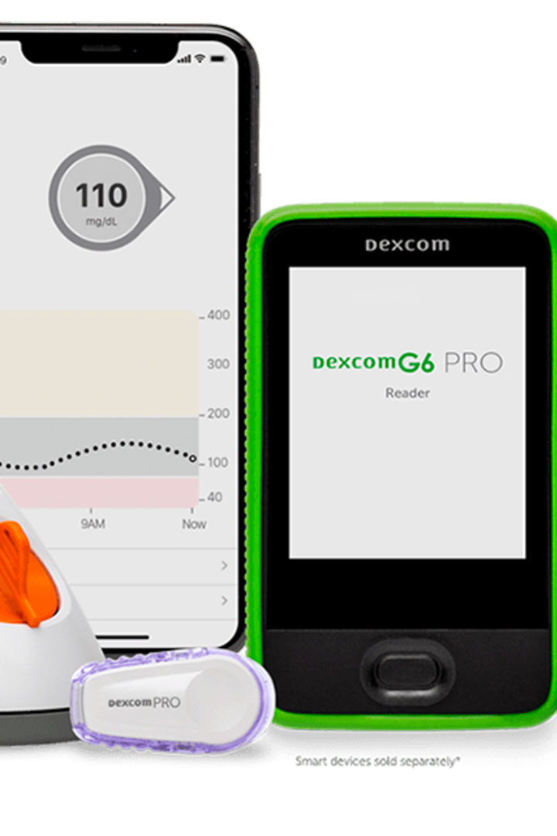
Benefits most important to patients
Safety and Real-time Monitoring
Blood Testing for Accuracy
Awareness of Emotional Attachment to Food
Unmet needs of patients
Cost & Insurance
Reliability and ease of access
Affordability
Integration and Compatibility

Slide 18
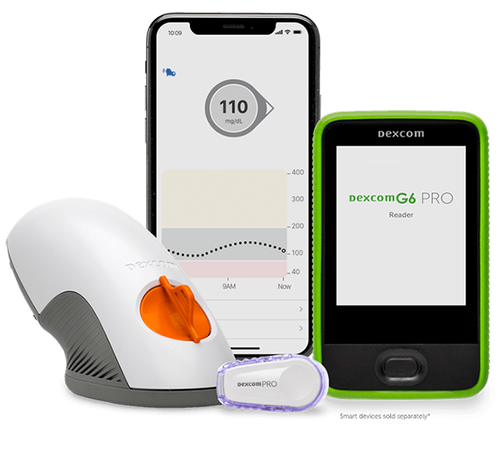
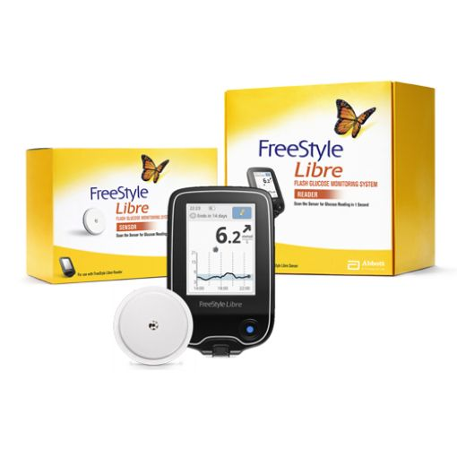
CGM Product- Related Analysis
Dexcom
Freestyle Libre
Notes:
A Dexcom CGM system tracks glucose levels continuously throughout the day and night. The glucose reading is sent to smart device † or receiver as frequently as every five minutes. Dexcom CGM systems then translate the readings into dynamic data so people are better able to manage their diabetes treatment.
The FreeStyle Libre system measures glucose levels through a small sensor — the size of two stacked quarters — applied to the back of your upper arm. It provides real-time glucose readings for up to 10 days, both day and night.

Slide 19
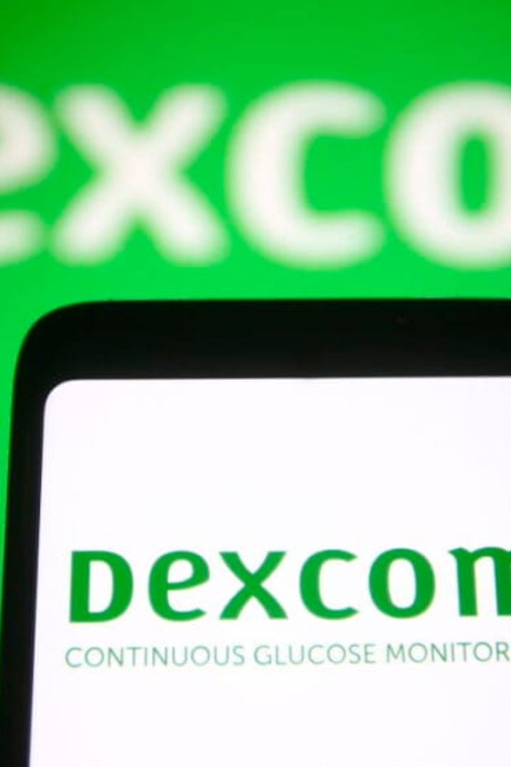
Praises of Dexcom
Covered by insurance and less co-payment
Does not require fingerstick for calibration
Accurate real-time glucose readings
Great recommendations for workout regime
Can be paired with apple and android devices

Slide 20
Complaints of Dexcom
Sensors needed replacement every once in a while
First time user faced symptoms like vomiting and nausea
Replacement of parts is a pain
Defective Dexcom being delivered
Not compatible with some older phones and devices
Resetting devices made dexcom non-functional
Issues regarding the bluetooth readings and calibration
Issues regarding the bluetooth readings and calibration

Slide 21

Praises of Freestyle Libre
Covered under insurance but might require medical prescription
Inspire other people by connecting through social media
Helps in constantly monitoring glucose
Libre app better than Dexcom app, frequent updates
Better than finger sticks

Slide 22
Complaints of Freestyle Libre
First timers needed help from the company
People found Dexcom better than Lifestyle Libre
Dexcom gave better readings comparatively
Received defective products
Accuracy and frequency of data is comparatively low
Complaints of product failing

Slide 23

Results from OpenAPI and Comparative Analysis
Provided Similar Results and recommendations
Picked up Additional Features, missed by manual analysis
Some incidents of Hallucinations observed
Comprehensive and easily understandable analysis
Can be used as a helping tool
Cannot be relied completely
Notes:
additional features like more products
hallucinations like not related to the sample

Slide 24
Recommendations for Brands
Dexcom
Improve the lifespan and reliability of sensors.
Ensure smoother replacement process.
Improve Bluetooth Connectivity.
Reduce Calibration Issues.
Freestyle Libre
Improve the accuracy and frequency of readings.
Reduce delivering defective products
Ensure stringent quality checks.
Improve insights and recommendations.

Slide 25

Recommendations for Customer
Dexcom appears to have a slight edge over Freestyle Libre because of 2 main reasons:-
Higher praise for accuracy
Real time monitoring and compatibility.
Final Recommendation :- Customers choice should depend on personal preference,specific needs and most importantly insurance situation.

Slide 26

Thank You!
~ Akshita, Aditi, Kaushal, Mia

Slide 27
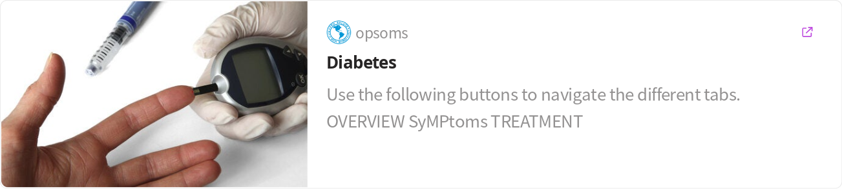
References

